Slide 1

Amjad Ashyab, Jewon Moon, Jeeho Bae
UCTP Prep
Instructor : Olivia Stark
May 14, 2015

Slide 2

→ Definition of Sepak Takraw.
→ History
a) Origin
b) Development
→ Explanation of the game
a) Rules
b) Ball and Court
→ Reflection
→ Conclusion
→ Critique

Slide 3

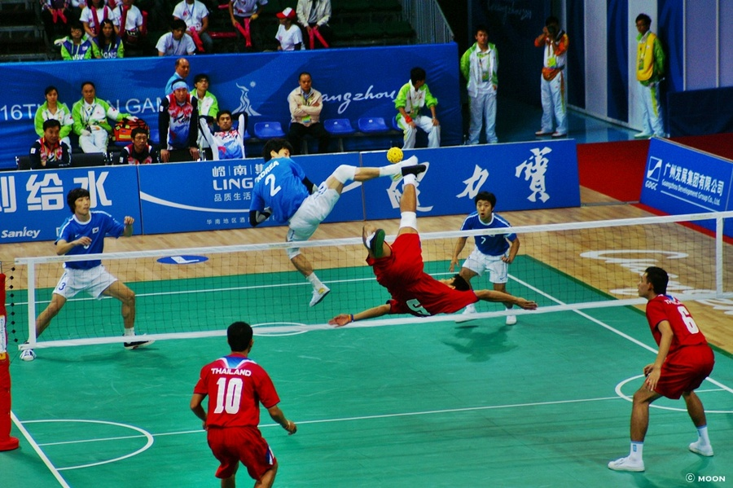
→ The game involves kicking the ball and similar to volleyball.
→ This has become a medal sport at the Asian Games.

Slide 4

→ Origin of the name
→ Two types of origin

Slide 5

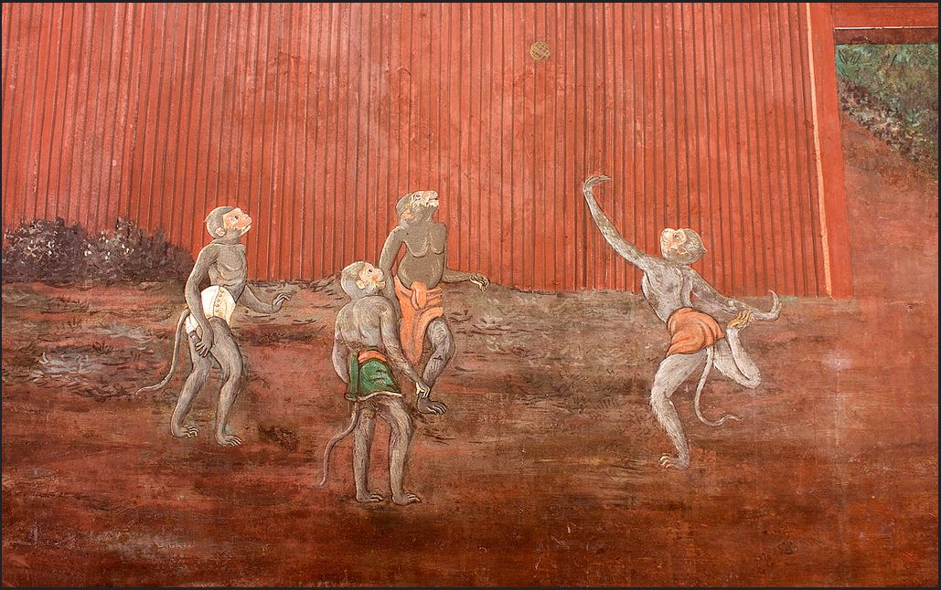
→ Who created this sports?

Slide 6

→ started from Malaysia in 15th century
→ How to spread out
→ Arguement between Malaysia and Thailand

Slide 7

→ Original style
- To bounce a ball with head and foot in one circle
- In 1891 : the change ( play in 1 circle → 2 circles)

Slide 8

→ Modern rule
- In 1829 : the Siam Sports Association made the first rules
- In 1833 : the application of the volleyball style net
- In 1960 : Malaysia, Singapore, Indonesia, Laos and Thailand made
the modern rules

Slide 9

→ International game
- In 1965 : the Asian Sepak Takraw Federation(ASTAF)
- In 1965 : the first international competition in Malaysia
at the South-East Asian Peninsular Games(SEAP Games)

Slide 10

- In 1985 : King’s Cup
- In 1990 : adoption of an official event at Asian Games in Beijing
- In 1992 : the International Sepak Takraw Federation(ISTAF)
- In 1997 : the first women’s championship in Tailand

Slide 11

→ Nowadays
- the professional league : 16 teams (from Thailand and Malaysia)
- the international events : King’s Cup and Super Series

Slide 12

→ It is similar to volleyball.
→ Three player in each team.
→ kick, knee, shoulder, or head a takraw ball back to the opposing team.
→ The point is lost or won.
→ The object of the game is for the team to score 15.

Slide 13

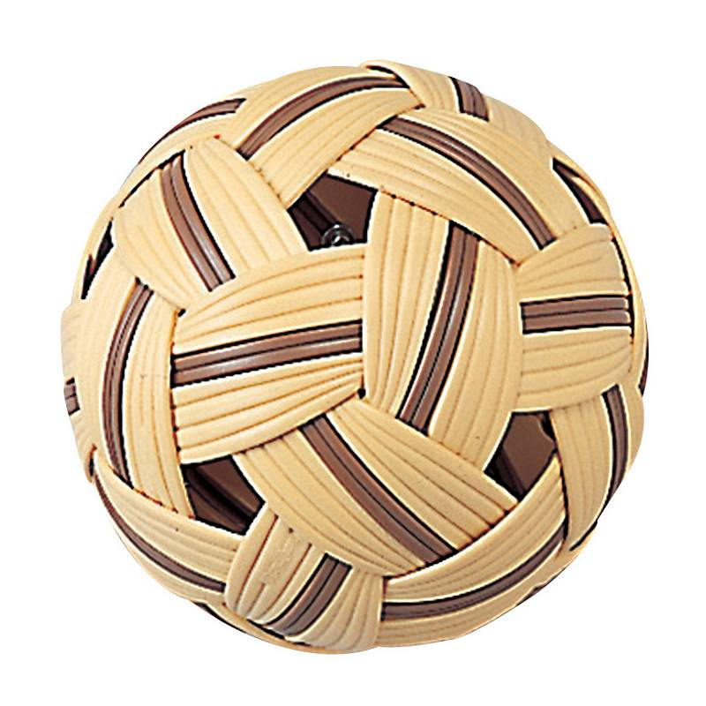
→ it is made of cone and planted as a single layer, and it has 32 faces.
→ The ball must not to be less than 15 inches nor more than 17 inches.
→ must have a weight that ranges from 170 to 180 g

Slide 14

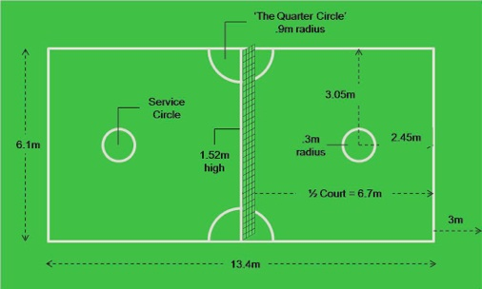
→ Area of 13.4m x 6.1m free
→ divides the court into equal halves
→ The width of the lines bounding the court should not be more than 4 centimetres

Slide 15

→ Sepak Takraw is one of the most active sports.
→ It helps to improve ability of body.
→ It is too difficult to learn.
→ Only young people can play it.

Slide 16

→ Sepak Takraw is the most popular sports in Southest Asia.
→ Southest Asia countries have been trying to make Sepak Takraw an international famous sport .
→ It has three players in each team.
→ The object of the game is to score 15.

Slide 17

→ The players will demonstrate safe and responsible behaviours to manage risks and prevent injuries in physical activity.

Slide 18

→ Shawn Kelley. Traditional Southeast Asian Sport. 10 July 2007. 10 May, 2015.
http://web.archive.org/web/20070710234948/http://www.tatnews.org/emagazine/2813.asp
→ Yutaka Nishiyama. The Sepak Takraw ball puzzle. 2012 . 11 May, 2015. http://www.ijpam.eu/contents/2012-79-2/9/9.pdf
→ Fred V. Perez. E. A, Scholer. Sepak Takraw. N D. 11 May, 2015
http://journals.humankinetics.com/AcuCustom/Sitename/Documents/DocumentItem/13249.pdf
→ http://www.sepaktakraw.org/about-istaf/sepaktakraw-heritage

Slide 19


